Slide 1
大數據分析: 葡萄酒評鑑
Members: 蘇亮羽 Su Liang Yu,黃柏皓 Wang Po Hao
Group: 7

Slide 2
Outline
Introduction
Materials and methods
Data set
Regularization
Algorithms
Result
Discussion
Conclusion
Reference

Slide 3
Introduction

Slide 4
Vinho Verde

Slide 5
Aim

Slide 6
Material and methods

Slide 7
Data set

Slide 8
Regularization

Slide 9
Algorithms
Bagging
description
Boosting
description
Decision tree
description
Linear regression
description

Slide 10


Flowchart
Linear regression
Comparison table
Data set
Decision tree
Pre-processing
Regularization
Bagging (random forest)
Boosting (adaboost)

Slide 11
Result and discussion

Slide 12
Pre-processing and regularization
Code
Figure

Slide 13
Algorithm comparison

Slide 14
Conclusion

Slide 15
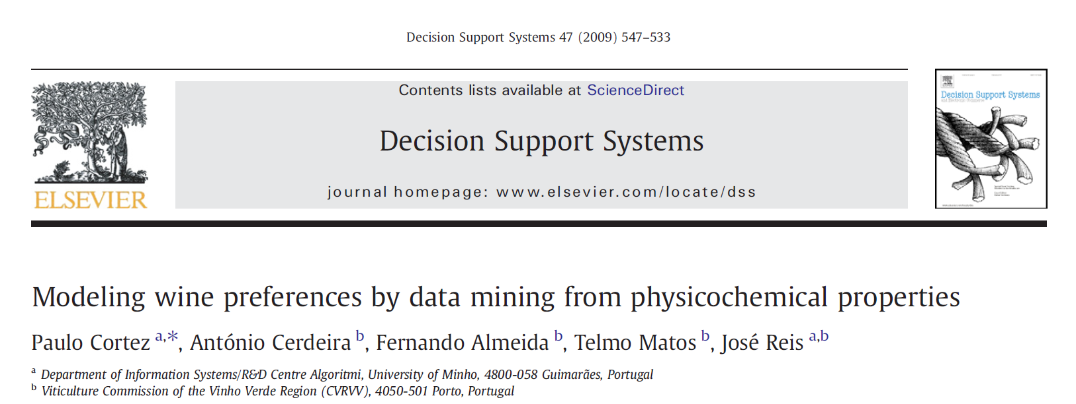
References
Paulo Cortez et al., “Modeling Wine Preferences by Data Mining from Physicochemical Properties,” Decision Support Systems 47, no. 4 (November 2009): 547–53, https://doi.org/10.1016/j.dss.2009.05.016.

